Slide 1
VR History @NMS
A unique VR experience at National Museum of Singapore
By: Winston & Jerryl

Slide 2
Scope of Application
Set in a museum, visitors are able to wear a VR headset and view in first-person a recreation of the past as well as artifacts belonging to that era.
A realistic recreation of scenes from warring eras as well as the stories being told from a narrative, aims to educate the younger generation as well as preserve memories from the past.
We have 2 months of office setup and 10 months of production time in which is split amongst the following:
3d modelling: 400 Mandays Designing: 100 Mandays UIUX: 50 Mandays
Development: 250 Mandays Sound: 100 Mandays

Slide 3
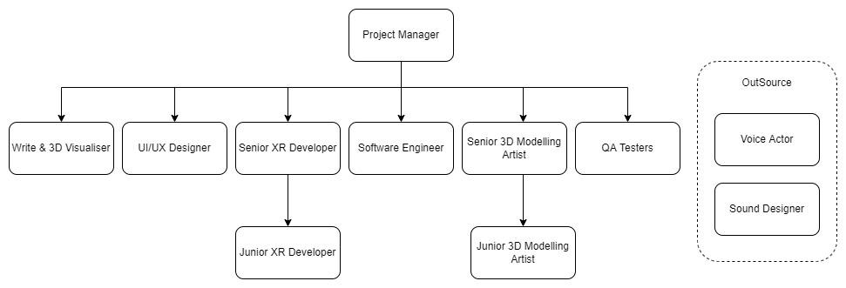
Team Setup and Roles

Slide 4
Salaries
Project Manager
Senior XR Developer
Junior XR Developer
Software engineer
Senior Modeller
Junior Modeller x 2
$5,000 monthly
$6,000 monthly
$4,500 monthly
$5,000 monthly
$5,000 monthly
$4,000 monthly

Slide 5
Salaries
UI/UX
Sound
QA Tester
Writer and 3D visualiser
$2,500 monthly
Outsourced for $1600
$2,500 monthly
$6,000 monthly

Slide 6
Mandays/Month:
Project Manager: 28 Mandays
Senior Developer: 25 Mandays
Junior Developer: 20 Mandays
Software Engineer: 25 Mandays
Senior Modeller: 25 Mandays
Junior Modeller: 20 Mandays
UI/UX: 25 Mandays
QA Tester: 20 Mandays
Write & 3D Visualiser: 20 Mandays

Slide 7
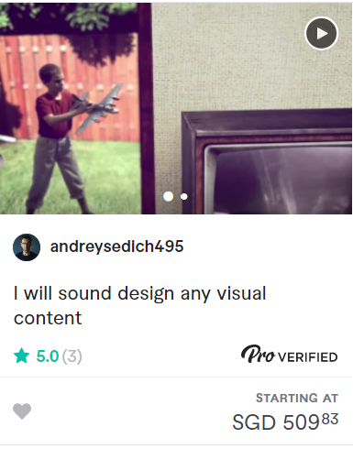
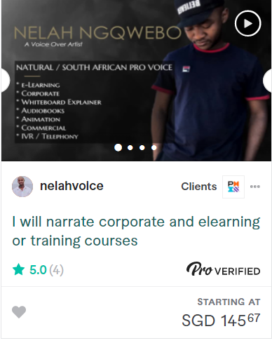
Outsourcing sound & voice acting
<- Professional sound design with variable prices and cleaning up of voice acting
Experienced voice actor that voices narration of learning courses, guaranteed to have clear intonation->

Slide 8
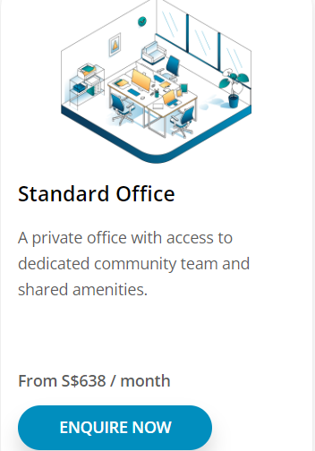
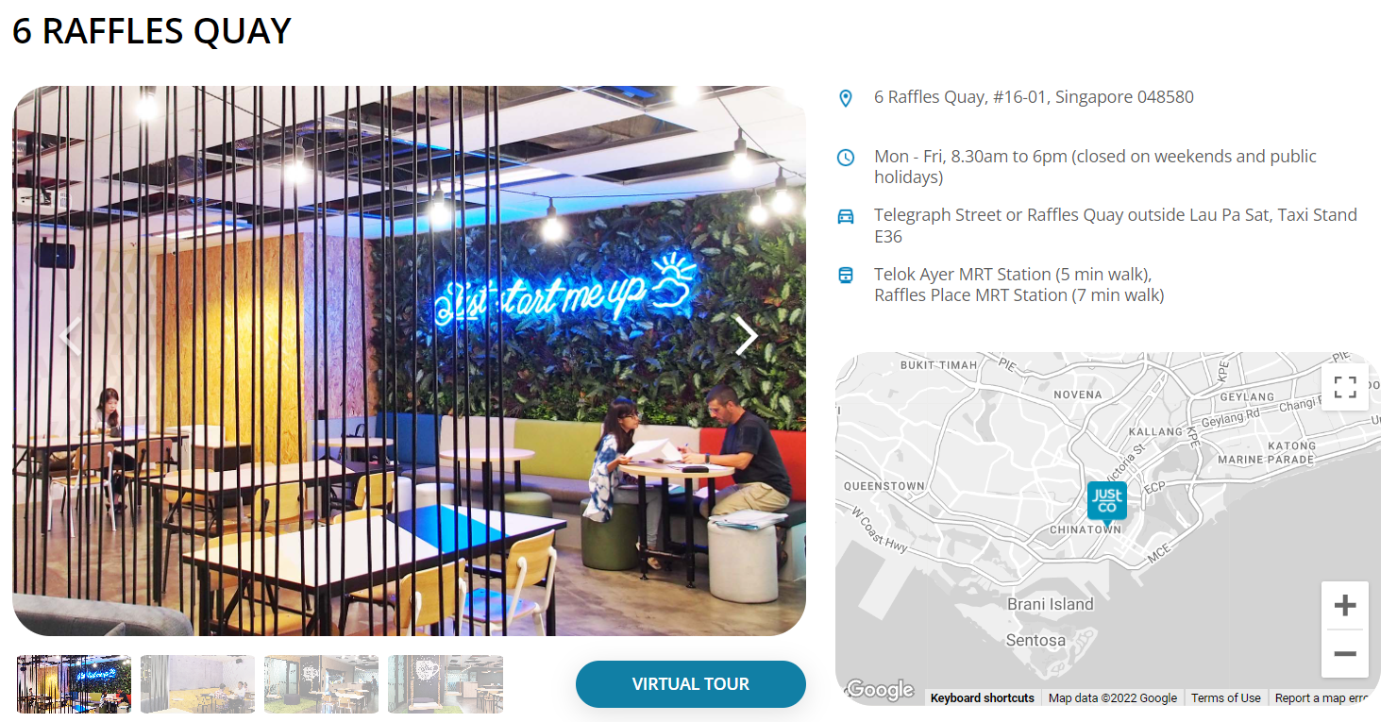
Rental of Office
Price: 700 monthly, subjected to change.
Capacity: 2-20 people
Why we chose this?
Office tables and chairs are inclusive in the rental, meaning that we do not have to spend time / money to put in the necessities for the office
5min walk from Telok Ayer Mrt / 7min walk from Raffles MRT

Slide 9
Capex
Laptop x 10
Huawei P30 Pro
Photometry App: Reality Capture
Oculus Quest 2 x2
Wacom One x 2
$12,000
$618
$400
$1000
$400

Slide 10
Capex for Company Setup
Company Incorporation Services
Company Secretary
Opening of Bank Account
$963
$856
$500
https://www.saporedicina.com/english/how-to-open-a-company-in-singapore/

Slide 11
12 month breakdown
Development timeline

Slide 12
Renting office
Hiring people
Start on scope
Start development
Artist creates model and cleanup
Outsource sound
Start on sprint 1
Software engineer makes sure code is clean
January
March
May
February
April
June
Designing flow
Finish hiring process
Start writing of scenes and narration
Developers work alongside artist to “virtualize” assets
Outsource sounds
Finish on minimum viable product with at least 75% satisfaction

Slide 13
Sprint 2
Adding necessary models
Sprint 3
Software engineer ensures code is up to standard
QA testing
Bug fixing
Polishing
July
September
November
August
October
December
Rescope design to ensure timeline is met
Prepare for third sprint
Polishing UI and finishing development
Cleaning up of audio, sound effects and voice lines
QA testing
Bug Fixing
Release

Slide 14
What are we asking for?
Bidding

Slide 15
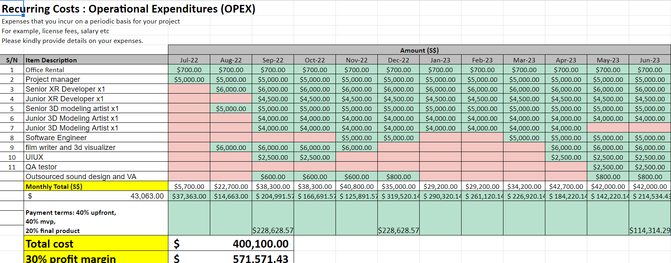
Cost incurred

Slide 16
30%
Profit margin

Slide 17
Payment Terms
30%
40%
30%
Upfront
Final Product
MVP
$148,009.67
$197,346.23
$148,009.67

Slide 18
What’s Next?

Slide 19
Who we are looking for
Junior XR Developer x2
Sound Developer x2
Junior Modeller
Marketing Personnel x2
Concept Artist x2
QA Testor
$4,500 monthly
$3,500 monthly
$4,000 monthly
$4,500 monthly
$3,000 monthly
$2,500 monthly

Slide 20
Why we need them
We are going to have to hire more people in the future as we want to expand our products to be simulate various situations during the wars.
How we are improving the project:
Add more features to use for other products
More Sounds
More Artifacts
Make areas that people can explore
Add more situations (battles)
Increase the amount of historical moments in our product (eg Impt Speeches)

Slide 21
Super Project
VR World with realistic Physics
Realistic Scenarios
Open World Mode with Different Maps
Multiplayer/user

Slide 22
250K
15%

Slide 23
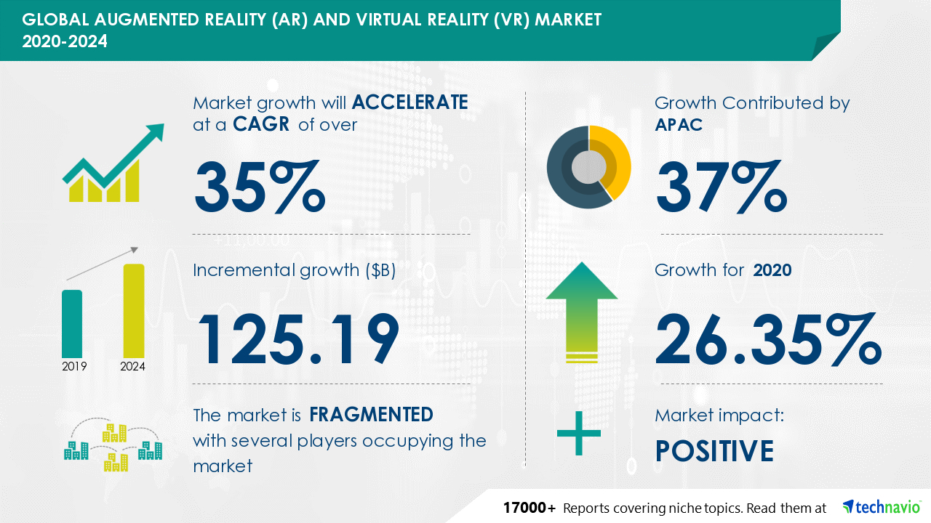
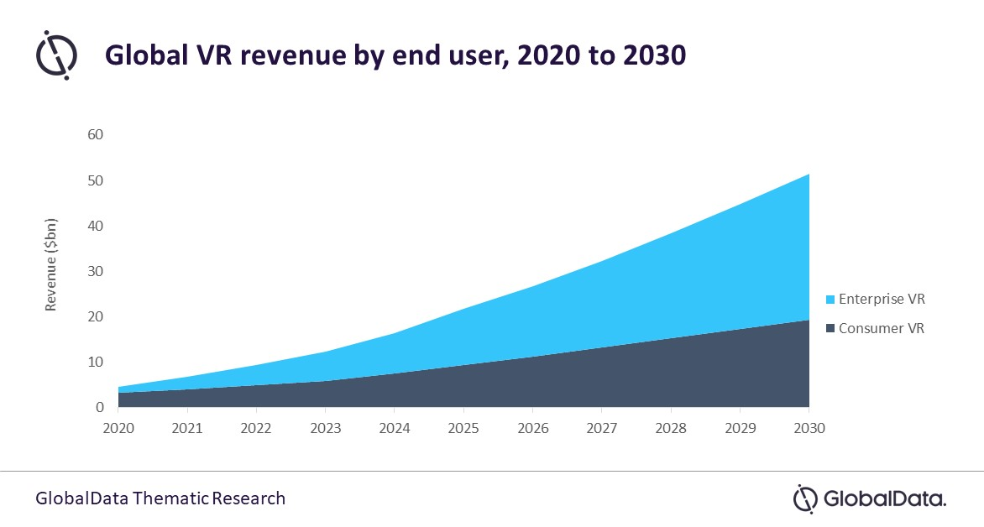
Market growth-trend

Slide 24
How much are we asking for?
We will take small projects during development of our super project, earning at least 300k per small project, to sustain costs.
This will continue for around 3 years, taking on 4 projects meanwhile.
The projects will pay for themselves as well as financial aid towards our concurrent super project
Hiring more people will allow sufficient manpower to split into 2 teams
Majority working on the side projects and improving software frameworks
This ensures that the side projects can be completed with a higher quality and thus more revenue
Minority starting designing and scoping of the super project
Development will not begin until the software and experience is up to par
Over time, the majority of people will be transferred over to the super project to facilitate major development

Slide 25
Tasklist & contribution
Jerryl | Capex | Office rental | Man days | Team Setup | Slides 40% | Future Employees | How we are expanding
WInston | Scope | Opex | Salaries + outsourcing | Timeline(development and planning) | Slides 60% | Future Funding bid

Slide 26
Sources
Excel sheet https://docs.google.com/spreadsheets/d/1EzPb5U0dwlFqBQ-HcrpWN4qJqecenTMC-MCNTAaNIFw/edit?usp=sharing
Job listings from glassdoor and skillsfuture.
Sound designer:
https://www.fiverr.com/andreysedich495/sound-design-any-visual-content?context_referrer=subcategory_listing&source=filtered_pro_gigs&ref_ctx_id=592aa713bb542608034a6d24f5fef1d2&pckg_id=1&pos=22&context_type=rating&funnel=592aa713bb542608034a6d24f5fef1d2&ref=pro%3Aany&imp_id=9ce469f6-4681-4b39-aa80-030cc42114e2
Voice actor:
https://www.fiverr.com/nelahvoice/record-male-voice-overs?context_referrer=subcategory_listing&source=filtered_pro_gigs&ref_ctx_id=f2384b4b419403e17b0ec6c78ede463f&pckg_id=1&pos=18&context_type=rating&funnel=f2384b4b419403e17b0ec6c78ede463f&ref=language%3Aenglish%7Cgender%3Amale%7Cpro%3Aany&imp_id=d59c64f7-4b18-4bcf-b7da-561c50f6679b
Startup net worth
https://www.logicboostlabs.com/blog/2020/02/17/calculating-valuation-for-your-startup#:~:text=Valuation%20based%20on%20revenue%20and%20growth&text=To%20calculate%20valuation%20using%20this,growth%20rate%20of%20the%20startup.

